Slide 1
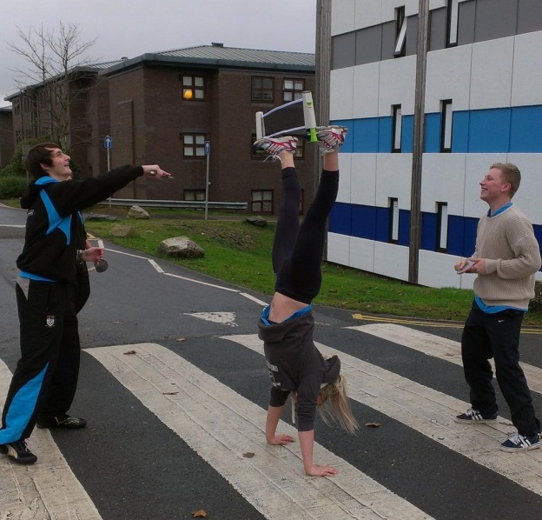
Working with Young People: Getting the Style Right
@justynprice

Slide 4
About you
You have the duration of the next song to think about and record your greatest interpersonal coaching achievement…
Notes:
Doorstep Sport – Right Style
Laissez-faire – but it isn't really
Local leaders and volunteers
Mixed age group
Not wearing sports gear
Not skills and drills - multi sport
Competitions

Slide 5
“Young people need to know that you care before they care what you know”
Prof. Dan Gould

Slide 6
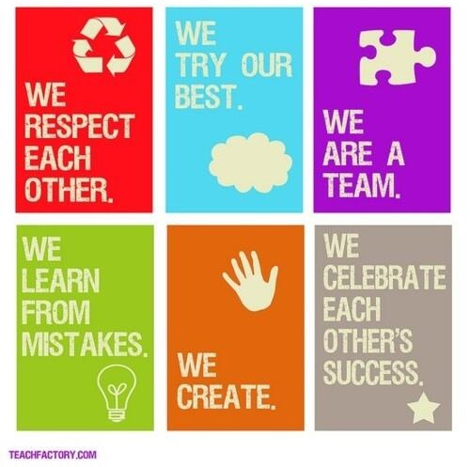

Slide 7
Our Mission Today…
Consider principles for “getting the style right”
Explore motivations of young people & ingredients of a great sessions
Define what young people / young adults think a top activator / coach is

Slide 8
Introducing StreetGames
National charity dedicated to reducing the gap in sports participation between affluent and poor communities
Delivered in partnership with a wide range of organisations
National Partner to Sport England
Award winning - sport for social good

Slide 9
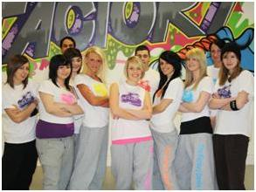
StreetGames & Doorstep Sport
Sport delivered close to home:
at the right time
in the right place
at the right price
in the right style…

Slide 10
Young people vote with their feet…

Slide 11
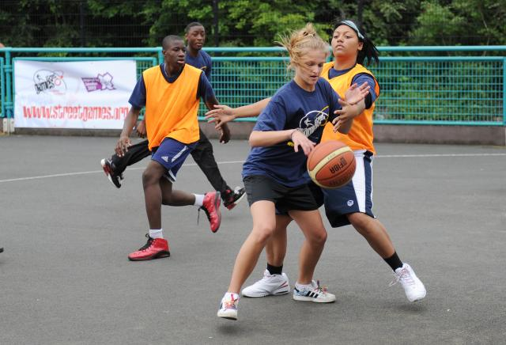
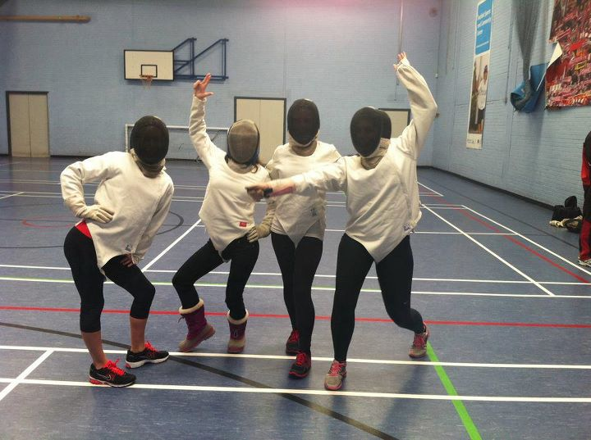
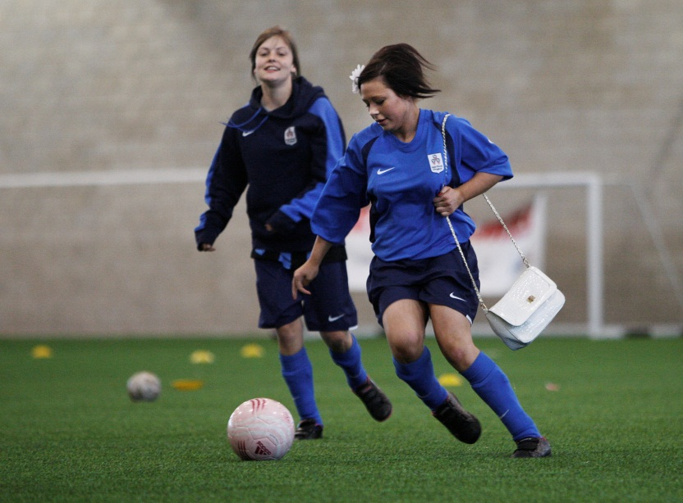
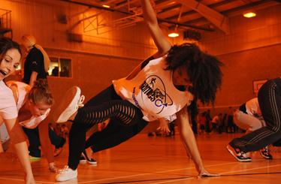
Right Style
Notes:
Doorstep Sport – Right Style
Laissez-faire – but it isn't really
Local leaders and volunteers
Mixed age group
Not wearing sports gear
Not skills and drills - multi sport
Competitions

Slide 12
Know your players
As an individual / small group share and record how you think the young person on each hand-out might respond to the questions about why do or don’t join in with sports activities?
Notes:
Doorstep Sport – Right Style
Laissez-faire – but it isn't really
Local leaders and volunteers
Mixed age group
Not wearing sports gear
Not skills and drills - multi sport
Competitions

Slide 13
Motivations to Participate:
Quotes from StreetGames study of young people studying vocational qualifications
Males | Females
Keep fit | Keep fit
Have fun | Lose weight
Lose weight | Have fun
Feel better | Feel better
Improve performance | Challenge
Gain new skills | Meet friends/socialise
Challenge | Relax/release/diversion
Train & complete | Gain new skills
Meet friends/socialise | Improve performance

Slide 14
Motivations

Slide 15
Current Activities

Slide 16
Main Barriers

Slide 17
Time Priorities

Slide 18
Encouraging Participation
Notes:
How could we encourage you to do more?

Slide 19
Ingredients for a Good Session
Choose top 9 ingredients from the pack of 20+ cards
Arrange top 9 into a diamond, most important on top row.
Notes:
Doorstep Sport – Right Style
Laissez-faire – but it isn't really
Local leaders and volunteers
Mixed age group
Not wearing sports gear
Not skills and drills - multi sport
Competitions

Slide 20
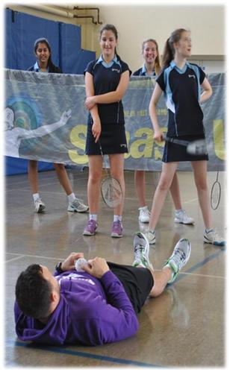
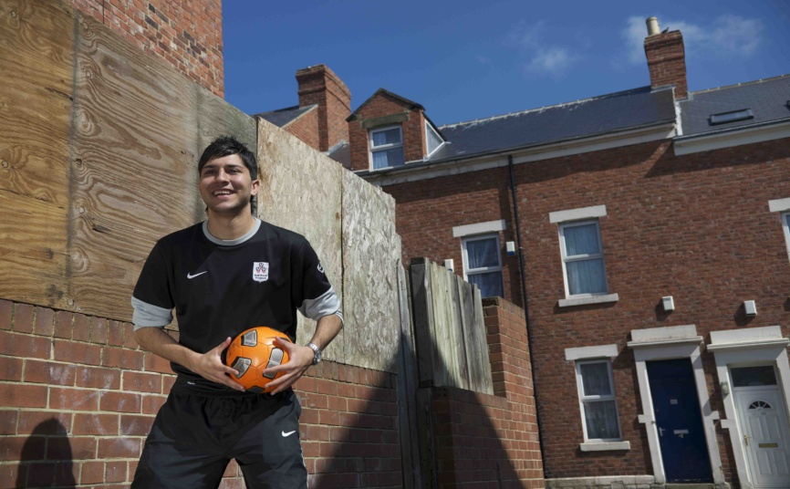
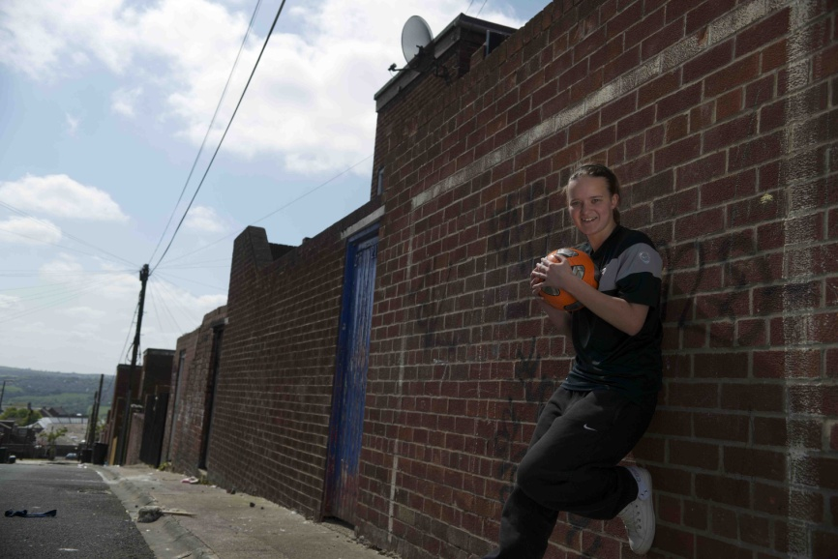
What Makes a Great Activator?

Slide 21
What Makes a Great Activator?
In your group discuss and make some notes on what skills, qualities & attributes you think a great Activator for 14-16 / 17-19 / 20-25 year olds needs to have?
Notes:
Doorstep Sport – Right Style
Laissez-faire – but it isn't really
Local leaders and volunteers
Mixed age group
Not wearing sports gear
Not skills and drills - multi sport
Competitions

Slide 22
What young people told us makes a great Activator?
Skills & Qualities of the Activator
Builds trust
Inspiring & Encouraging
Knowledgeable & easy to understand
Down to earth and real
Open & helpful
Non judgemental
Positive, welcoming to all
Mentoring
A role model
Consistent
Skills & Qualities of the Activator
Motivational & Supportive
Relaxed, friendly & approachable
In for the long-haul
Ability to listen & be responsive
Experienced & suitably qualified
Mindful
Able to support transitions
Passionate about sport & physical activity
Sign posting
Shared values

Slide 23
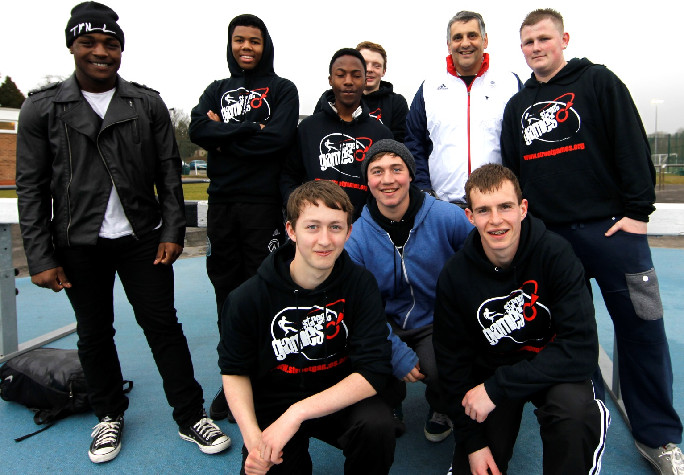
If you want to match with theory…
Competence
Confidence
Connection
Character & Caring
Creativity

Slide 24
From the following list select the 4 or 5 words which best sum up your Activity philosophy.
Activity Philosophy
Play | Confidence | Fun | Inclusive | Win
Creativity | Passion | Growth | Friendship | Hard work
Commitment | Skills | Learning | Participation | Performance
Goals | Social | Technical | Strength | Citizenship
Future | Present | Experience | Results | Variety
Style | Challenge | Safe | Independent | Development
Informal | Players | Young People | Confident | Leaders
Enjoyment | Achievement | Self Esteem | Competence | Encouragement

Slide 25
Put the words together in 1 or 2 sentences for you to refer back to in the future.
Activity Philosophy
Fun
Performance
Challenge
Safe
Creative

Slide 26
“I will deliver fun sessions in a safe environment. I will encourage young people to be creative to solve the challenges I share with them in order to develop their performance.”
Activity Philosophy

Slide 27
Action Planning
Based on today’s workshop, list…
1 thing you are going to STOP doing
1 thing you are going to START doing
1 thing you are going to CONTINUE to do

Slide 28
Our Mission Today…
Consider principles for “getting the style right”
Explore motivations of young people & ingredients of a great sessions
Define what young people / young adults think a top activator / coach is

